Slide 1
What You
Need to Know
About Financial Aid
Greenfield High School Financial Aid Night

Slide 2
Topics We Will Discuss
What is financial aid?
Cost of attendance (COA)
Student aid index (SAI)
Financial need
Categories, types, and sources of financial aid
Free Application for Federal Student Aid (FAFSA®)
Special and unusual circumstances
Next steps, after FAFSA is completed

Slide 3

What Is Financial Aid?
Financial aid consists of funds provided to students and families to help pay for postsecondary educational expenses

Slide 4




What Is Cost of Attendance (COA)?
Tuition and fees
Housing and food (living expenses)
Books, course materials, supplies and equipment
Transportation
Miscellaneous and personal

Slide 5
What Is Student Aid Index (SAI)?
Student contribution
Number resulting from the evaluation of a student’s (and family’s) approximate financial resources for a student’s postsecondary education
Parent contribution
(for dependent students)

Slide 6
What Is Financial Need?
Cost of attendance (COA) – Student aid index (SAI) = Financial need

Slide 7
Categories of Financial Aid
Need-based aid
Non-need-based aid

Slide 8
Types of Financial Aid
Scholarships
Grants
Loans
Work-Study Employment
Self-Help Aid
Gift Aid

Slide 9
Scholarships
Scholarships
Grants
Loans
Work-Study Employment
Self-Help Aid
Gift Aid

Slide 10

Scholarships
Where do scholarships come from?
  Colleges/Universities
  Civic Organizations/Private businesses
  Parental affiliations
  Online Searches (fastweb.com)
What are scholarships based on?
  Merit
  Need
  Involvement/Activity/Leadership etc.
  Just for being YOU!

Slide 11
Scholarships –Your Scholarship Search
Start Now!
  Use Search Engines to find matches
Begin close to home
  Affiliations, Chamber of Commerce, Parent’s workplace
Look at the college/university websites Scholarship Search Engines
  What is your “Brand” essay template; who you are, what kind of education you are seeking, how you are going to impact the world
  Set up a separate email just for Scholarship tracking

Slide 12
Grants
Scholarships
Grants
Loans
Work-Study Employment
Self-Help Aid
Gift Aid

Slide 13
Grants
Typically Need-Based Aid
Federal and State options per eligibility
Funding that does not need to be paid back

Slide 14
Work-Study Employment
Scholarships
Grants
Loans
Work-Study Employment
Self-Help Aid
Gift Aid

Slide 15
Federal Work Study/ Employment
Federal Work Study
Institutional Work Programs
Off campus/summer employment
Paid internships
*Studies show that students who work part-time perform better academically*

Slide 16
Loans
Scholarships
Grants
Loans
Work-Study Employment
Self-Help Aid
Gift Aid

Slide 17
Loans
Federal Direct Loan Program
  Subsidized-based on need
  Unsubsidized
Federal Parent PLUS Loan
  (Parent Loan for Undergraduate Students)
State Loans
Other Loans

Slide 18
PLUS Loan Details
PARENT borrows on behalf of undergraduate student
Must pass a basic credit check
  If parent is DENIED, additional funding may be made available for the student
Two repayment options
  60 days after last payment
  Opt-in to an in-school deferment option

Slide 19
State Loans/ Other Loans
Examples of State Loans
  Nursing loan
  Minority Teacher Loan
  Teacher Loan
Example of Other Loans
  Private student loans
  College/University may have an institutional loan

Slide 20
Sources of Financial Aid
Federal Government
Employers
States
Private Sources
College and Universities

Slide 21
Federal Government
Largest source of financial aid
Aid provided primarily based on financial need
Must apply each year using the FAFSA
Eligibility requirements must be met

Slide 22
Federal Student Aid Programs
Federal Pell Grant
Federal Supplemental Educational Opportunity Grant (FSEOG)
Teacher Education Assistance for College and Higher Education (TEACH) Grant
Federal Work-Study (FWS)
Federal Direct Student Loans (Direct Loans)
Federal Direct PLUS Loans

Slide 23
States
Residency requirements usually apply
Aid may be provided based on
both merit and need
Use information from the FAFSA and/or state aid applications
Deadlines vary by state

Slide 24
State Student Aid Programs in Wisconsin
Wisconsin Grant
TIP
(Talent Incentive Program)
TAG
(Tuition Assistance Grant)
WI Veterans Grant
WI Academic Excellence Program
Minority Grant
(under review by the State)

Slide 25
Colleges and Universities
Aid provided based on both merit and financial need
Aid may be gift aid or self-help aid
Use information from the FAFSA and/or institutional applications
Deadlines and application requirements vary by institution

Slide 26
Private Sources
Foundations, businesses, churches, civic,
and charitable organizations
Deadlines and applications procedures vary
Begin researching private sources early

Slide 27
Employers
May have scholarships available
to the children of employees
May have educational benefits for their employees

Slide 28
Free Application for Federal Student Aid (FAFSA®)
Collects demographic and financial information
Information used to calculate the student aid index (SAI)
Colleges use SAI to offer financial aid
Available in English and Spanish

Slide 29
Free Application for Federal Student Aid (FAFSA)
May be filed at any time during an academic year, but typically no earlier than October 1st prior to the academic year for which the student requests aid
Colleges may set FAFSA priority dates

Slide 30

Free Application for Federal Student Aid (FAFSA)
Online FAFSA
www.studentaid.gov

Slide 31
Benefits of Using Online FAFSA
Built-in edits to prevent costly errors
Skip-logic allows student and/or parent to skip unnecessary questions
No need to manually enter federal tax information (FTI)

Slide 32
Benefits of Using Online FAFSA
More timely submission of original application and any necessary corrections
More detailed instructions and “help” for common questions
Ability to check application status online
Simplified application process

Slide 33
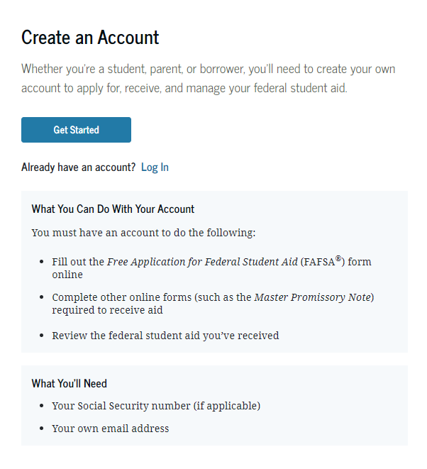
StudentAid.gov Account Username and Password (FSA ID)
Used for FAFSA completion and access to certain U.S. Department of Education websites
Student and parent must create own FSA ID
May be used throughout financial aid process, including subsequent school years
Only the owner should create an
FSA ID
Apply at https://studentaid.gov/fsa-id/create-account/launch

Slide 34
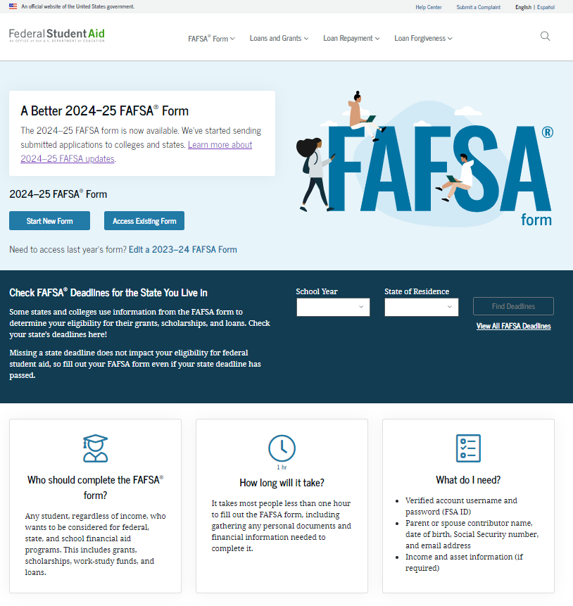
Online FAFSA

Slide 35
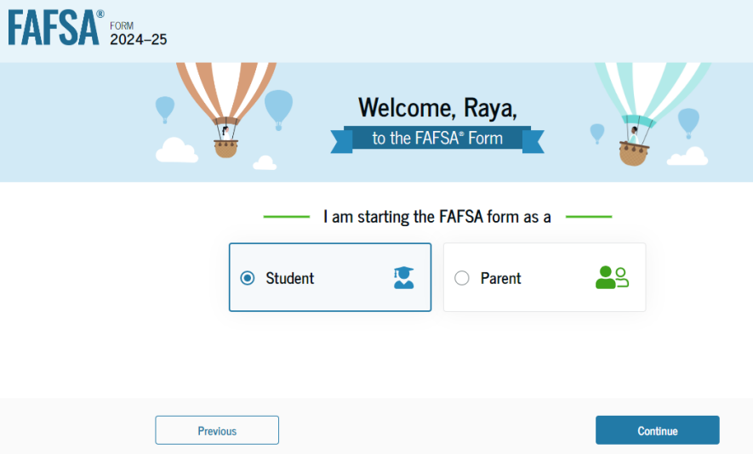
Online FAFSA
Note: Screenshot from U.S. Department of Education’s
2024-25 FAFSA Form Preview Presentation, July 2023

Slide 36
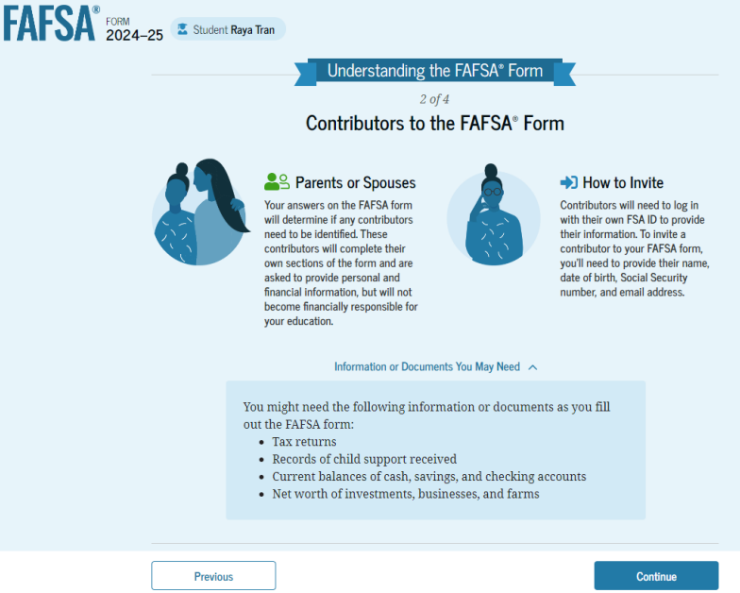
FAFSA Contributors
Note: Screenshot from U.S. Department of Education’s
2024-25 FAFSA Form Preview Presentation, July 2023

Slide 37
FUTURE Act Direct Data Exchange (FA-DDX)
Allows for an individual’s federal tax information (FTI) to be directly transferred from the IRS to the FAFSA
Consent is required by all contributors on FAFSA
IRS transfers information to populate FAFSA income questions for most tax filers
Eliminates manual entry of tax and income information

Slide 38
Student Information
Identity and contact information
Consent for FTI transfer from IRS
Marital status
College plans
Personal and unusual circumstances

Slide 39
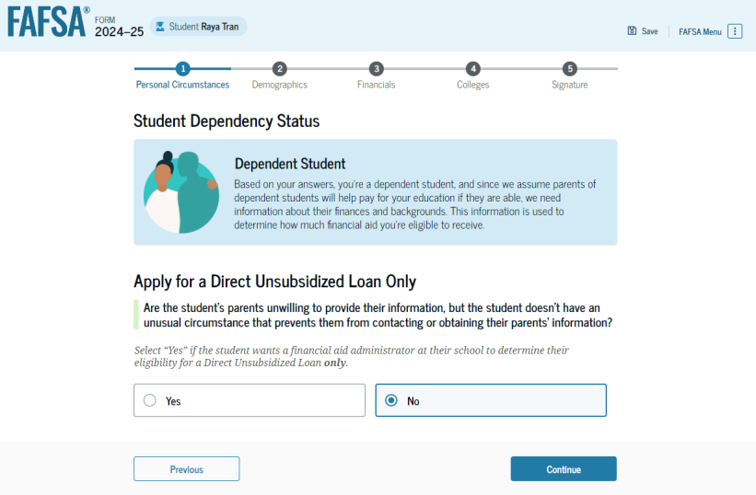
Student Dependency Status
Note: Screenshot from U.S. Department of Education’s
2024-25 FAFSA Form Preview Presentation, July 2023

Slide 40
Unusual Circumstances
Conditions that justify an institution making an adjustment to a student’s dependency status
Student does not provide parental data on FAFSA
    Considered provisionally independent
Student follows institution’s process for dependency override determination

Slide 41
Student Information
Demographic information
Citizenship status
Parents’ education status
Parent killed in line of duty
High school information

Slide 42
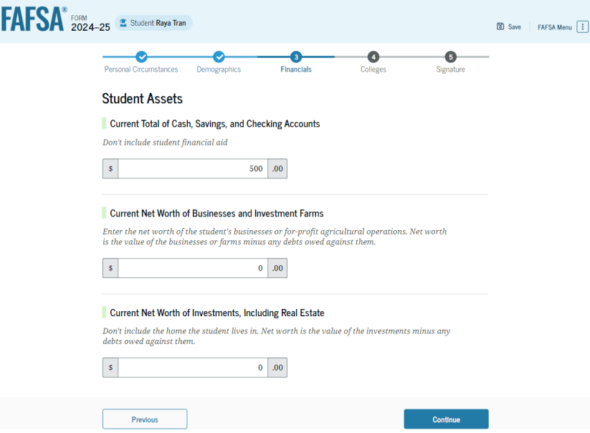
Student Financial Information
Tax return information
  Minimal questions if
  FTI transferred from IRS
Asset information
Note: Screenshot from U.S. Department of Education’s
2024-25 FAFSA Form Preview Presentation, July 2023

Slide 43
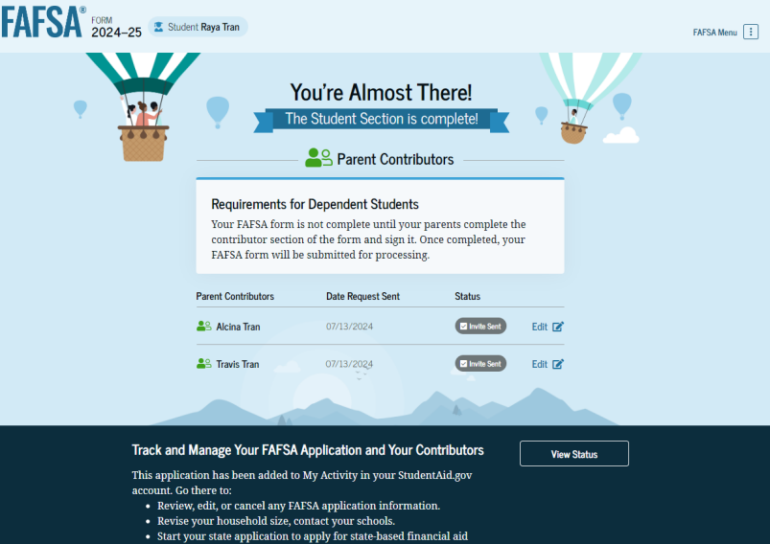
Student Section Completion
College selection
Review of information
Signature

Slide 44
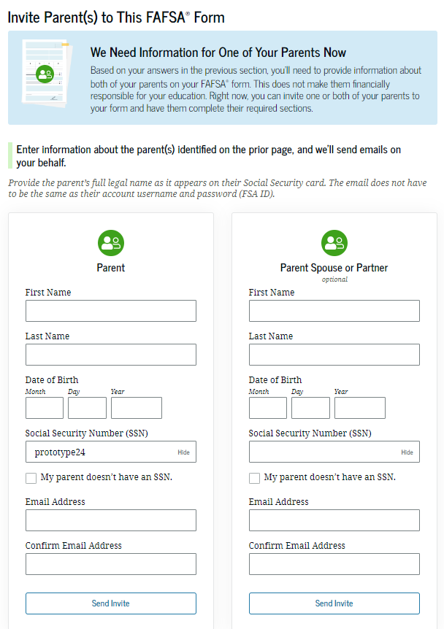
Student Invites Parents to FAFSA
Student provides personal information about parents to invite them to complete parent portion of the FAFSA
Note: Screenshot from StudentAid.gov

Slide 45
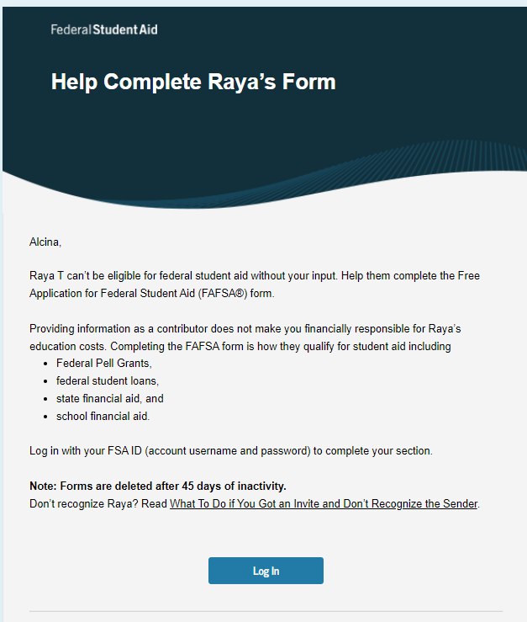
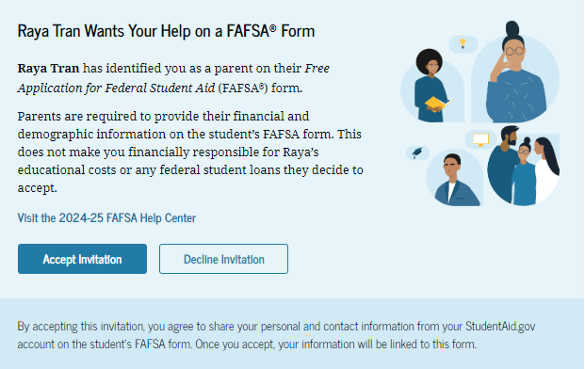
What is the parent’s view
Will receive an email inviting them to complete the FAFSA
Invite expires after 45 days
Parents must use FSA ID to access FAFSA

Slide 46
Parent Information
Identity and contact information
Consent for FTI transfer from IRS
Marital status
State of legal residence

Slide 47
Parent Financial Information
Receipt of means-tested federal benefits in the previous two years
Tax filing status
Family size and number in college
Tax return information
  Minimal questions if FTI transferred from IRS
Assets
Other parent information

Slide 48
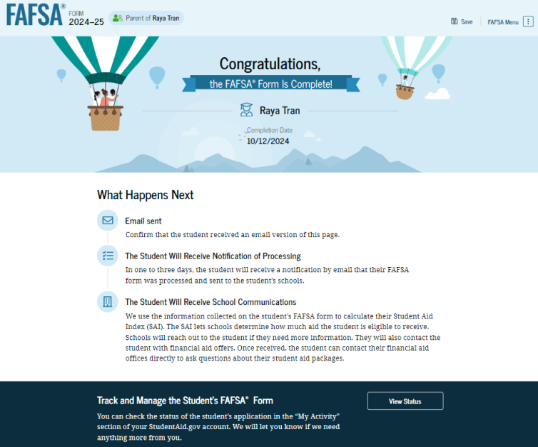
Parent Section Completion
Review of information
Signature and submission of FAFSA
Note: Screenshot from U.S. Department of Education’s
2024-25 FAFSA Form Preview Presentation, July 2023

Slide 49
Other Considerations
If independent student is married, spouse information is required as well
Consent to transfer FTI from the IRS is required for ALL contributors
  Including student, student’s spouse (if applicable), parent, and other parent (if applicable)
Students, parents, and preparers may start, complete, and submit a FAFSA

Slide 50
Who Is Included in Family Size?
Dependent Applicants
Student
Independent Applicants
Parent (and spouse)
Parent’s dependent children, even if they live apart from the parent because of college enrollment*
Other people if they live with the parent*
Student (and spouse)
Student’s dependent children, even if they live apart from the student because of college enrollment*
Other people if they live with the student*
* Included only if providing more than half of their support between July 1, 2024 and June 30, 2025

Slide 51



FAFSA Processing Results
FPS
College
Student

Slide 52
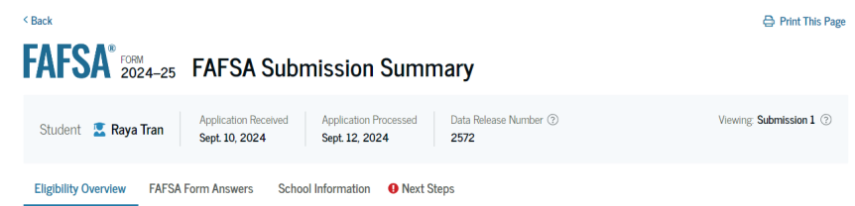
FAFSA Submission Summary
Four sections:
  Eligibility Overview
  FAFSA Form Answers
  School Information
  Next Steps
Ability to print summary
Note: Screenshot from U.S. Department of Education’s
2024-25 FAFSA Form Preview Presentation, July 2023

Slide 53
Institutional Student Information Record (ISIR)
FPS sends results to colleges listed on the FAFSA
College reviews ISIR and may request additional documentation

Slide 54
Making Corrections
If necessary, corrections to FAFSA data may be made by:
Using online FAFSA;
Submitting documentation to college’s financial aid office

Slide 55
Special Circumstances
Different than unusual circumstances (dependency overrides)
Unique conditions exist that cannot be documented with the FAFSA, or circumstances have changed since filing
Student should contact institution’s financial aid office for more information
Decisions are final and cannot be appealed to U.S. Department of Education

Slide 56

Special Circumstances - Examples
Unusual uncovered medical/dental expenses
Divorce
Extraordinary dependent care
Parent or spouse death
Additional family members in college
Loss of employment or income

Slide 57
My FAFSA is Complete, Now What?
Follow instructions on your financial aid letter
  Log on to school's student website/portal
  View and Accept (if required) your aid offer
Loans
  If borrowing Federal loans
    Master Promissory Note
    Entrance Counseling

Slide 58
What if your offer is not enough?
Parent PLUS loan
Private Student Loan
  The student is the borrower, but will likely need cosigner
  Some Parent Private loans are available
Payment plan options
  Balance divided either over the semester or academic year—will vary depending on school

Slide 59
That’s Good to Know
The FAFSA and aid is an annual process, not ‘one and done’
Scholarships are NOT just for freshman
Watch for scams
FERPA, students sign a Consent Release form

Slide 60

Thank You!
Blake Taylor
Assistant Director of Financial Aid
Alverno College
(414) 382-6262
financial.aid@alverno.edu
www.alverno.edu

